Slide 1
Earning Three Hours of GT Credit - Include your name, grade and campus please on this slide
Example: Slide 1: Title of Work Stations
PowerPoint Template for Submission
Poetry- Week 1
Work Station 1
Poetry - Week 2
Work Station 2
Geometry
Work Station 3

Slide 2
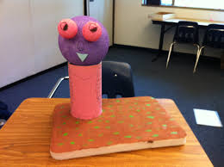
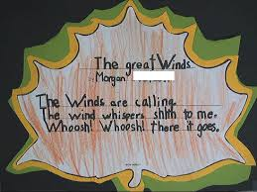
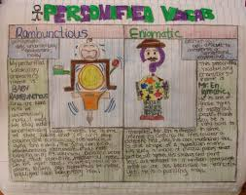
Slide 2: Documentation of Student Participation
Work Station 1
Work Station 2
Work Station 3
Notes:
Include pictures
Documents participation
Take a photo of a student product from their work at this station

Slide 3
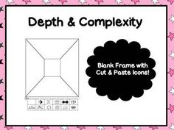
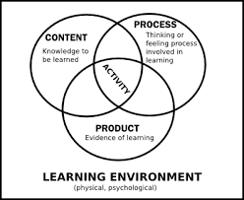
Slide 3: Work Station 1 Summary
Add photo of process here:
Which objective did you focus on?
3.18(B) write poems that convey sensory details using the conventions of poetry (e.g., rhyme, meter, patterns of verse)
Which differentiation process did you use? In the poetry example, I could differentiate in the process. For example, I could have given the student 2 or 3 depth and complexity icons and said choose 1 to use to compose your poem.
Notes:
For example, maybe the icons I chose were patterns, change over time, and ethics. So as the student is composing his/her haiku he/she would have to think about which icon to use. For example, if the student chose ethics - the poem might revolve around the environment and conservation, or an endangered species, etc. If choosing patterns, the student might reflect on the different patterns in the structure of poetry. Changes over time might include a topic for the poem that demonstrates a type of slow change that occurs in nature.

Slide 4
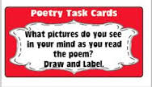
Slide 4: Work Station 2 Summary
Add photo of process here:
Which objective did you focus on?
1.18(B) write short poems that convey sensory details
Which differentiation process did you use? Again I would differentiate in the process using the depth and complexity icons. For example, I would have the students draw the big idea of the poem and then using their senses only draw what they might see or smell, taste, touch or hear. Finally I would use the pattern or rules icon to have them follow a frame to create their own example.
Notes:
For example, maybe the icons I chose were patterns, change over time, and ethics. So as the student is composing his/her haiku he/she would have to think about which icon to use. For example, if the student chose ethics - the poem might revolve around the environment and conservation, or an endangered species, etc. If choosing patterns, the student might reflect on the different patterns in the structure of poetry. Changes over time might include a topic for the poem that demonstrates a type of slow change that occurs in nature.

Slide 5
Slide 5: Work Station 3 Summary
Which objective did you focus on?
Which differentiation strategy did you use?
Add photo of process here:

Slide 6
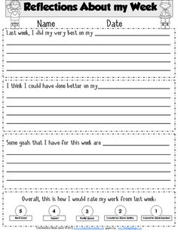
Slide 6: Work Station-Student Reflection of Learning Journey
Work Station 1
Work Station 2
Work Station 3
Notes:
Student quotes
Exit ticket, draw picture, plus delta, anchor chart responses, take picture and upload to the PPT.

